Slide 1
Homework Part 1
Submitted by: Menaka Katapadi Kamath Email id: mxk165230@utdallas.edu Language used: Python IDE: Jupyter Notebook

Slide 2
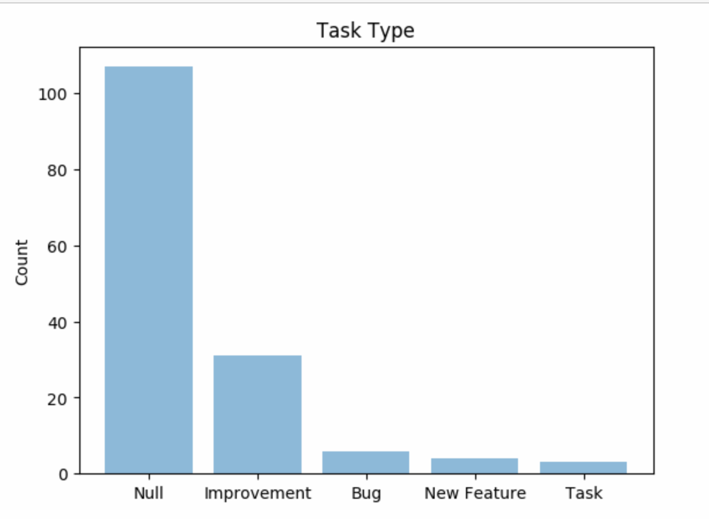
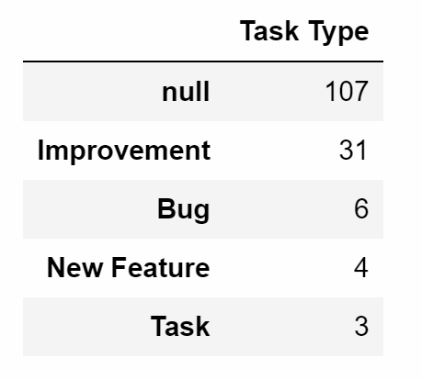
a) What is the most common task type in Repository 642?
1.Python Data Frame object depicting the Task Type with the occurrence of the task type in the data set
2. We can see from the diagram above that most common task type is Improvement. We can ignore the null task type.

Slide 3
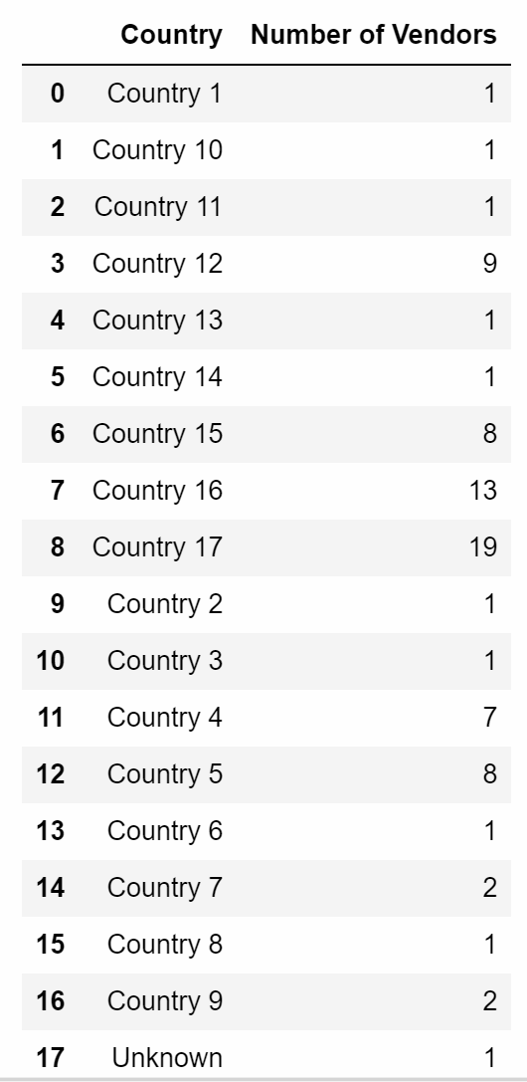
b) How many Vendors are used in each country?
To our left, we can see the python data frame object that denotes the number of vendors for each country.

Slide 4
What Percentage of the total projects working with Java Files?
I first calculated the total number of projects by finding out the size of the list that contains the unique values of project names.
I then used groupby clause for the the ‘FileType’ csv file, based on Project and Filetype to find the number of projects using Java Files. Finding out the size of the this groupby object, I could get the number of projects using Java.
By dividing Number of Java Projects by total number of projects, I arrived at the number below.
57.83 %

Slide 5
What is the average number of Developers in all the repositories and What is the average number of Repositories in all the Projects?
Average number of developers in all repositories - 103.487
Average number of repositories in all projects- 21.36740

Slide 6
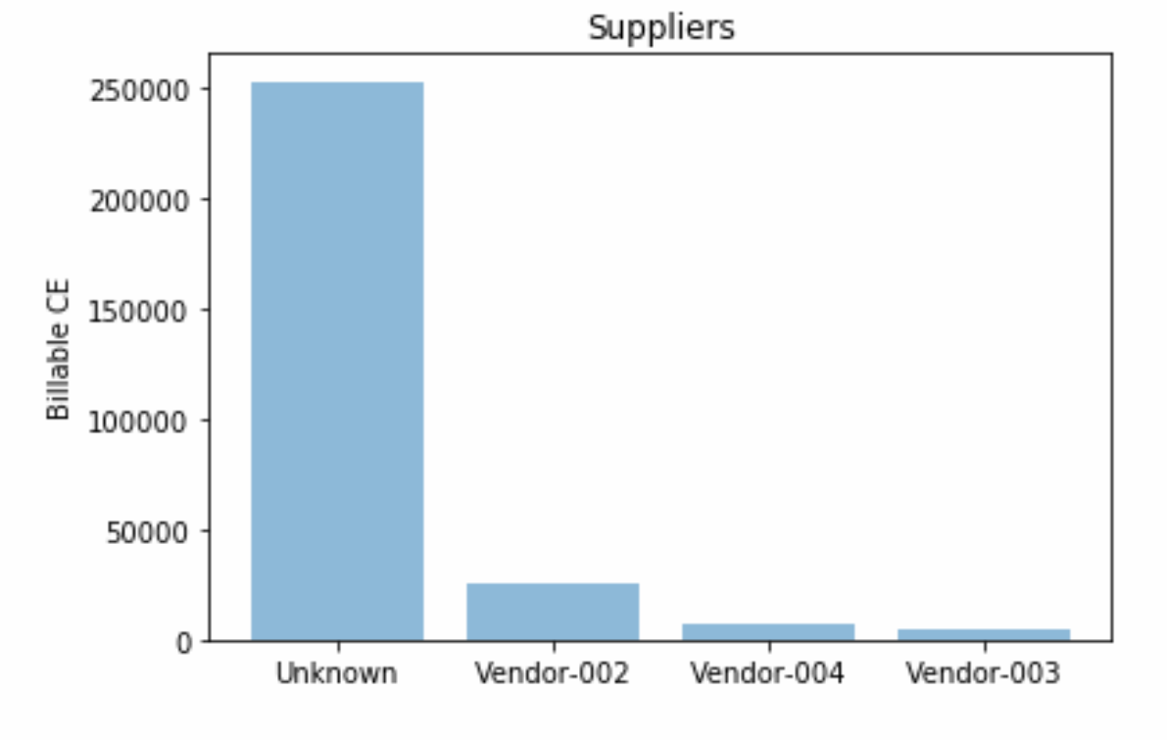
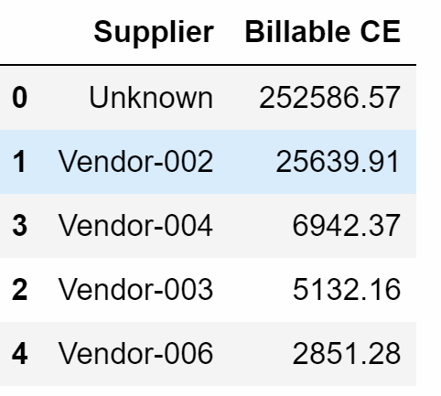
Which are the Top 3 Suppliers in terms of Billable Coding Effort (CE) Delivered per developer?
1.Python Data Frame object depicting the Top 3 suppliers
Bar graph above depicts top 3 suppliers in terms of Billable CE delivered per developer.

Slide 7
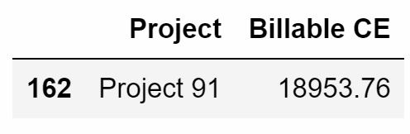
f) Which is the Project with a maximum number of Billable CE hours per day delivered per developer?
Above is a python dataframe object indicating Project 91 as the project with maximum number of billable CE hours per day delivered per developer.

Slide 8
What is the difference on the total Actual CE delivered between July and August in Country 17?
For July, the actual CE was 19316.10
For August, the actual CE was 17489.239
Difference between the two is
1826.86

Slide 9
What is the total number of developers in each one of the last 3 months for Vendor-002?
366

